Slide 1
Battle of the Neighborhoods
Capstone project – Shobha Ramkrishnan

Slide 2
Introduction / Business Problem
New York is a big city and is most populous and most densely populated city in the United States. The city has a diverse culture and has been the premier gateway for legal immigrants. This makes it the most culturally and linguistically diverse city in the world. This also means that New York offers a diverse cuisine and varied restaurants.
This analysis will try to help an hotelier gauge on which will be the best location in New York to open an Indian restaurant.
This case can easily be applied to any restaurant to be opened and will help hoteliers gauge the market and neighborhood to get into restaurants business

Slide 3
Data
https://cocl.us/new_york_dataset - Data on New York City with Boroughs, Neighborhood to get an insight on the neighborhood
Fousquare API - Data to get into neighborhoods and venues to get details on Indian restaurants to find which place an Indian restaurant is most popular and also to get details on the competition and kinds of menus offered.
https://data.cityofnewyork.us/City-Government/Borough-Boundaries/tqmj-j8zm – New York Boroughs boundary

Slide 4
Methodology
Explore data of New Your city from https://cocl.us/new_york_dataset
Use FourSquare to find venues for each neighborhood.
Filter out all venues that are Indian Restaurants.
Get details on rating , tips and likes for restaurant location wise
Get geopy to get coordinates
Use folium to visualize via maps

Slide 5
Discussion
Explore data of New Your city from https://cocl.us/new_york_dataset
Use FourSquare to find venues for each neighborhood.
Filter out all venues that are Indian Restaurants.
Get details on rating , tips and likes for restaurant location wise
Visualize

Slide 6
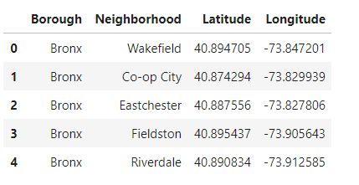
Neighborhoods
There are 5 Boroughs and 306 neighborhoods in New York

Slide 7
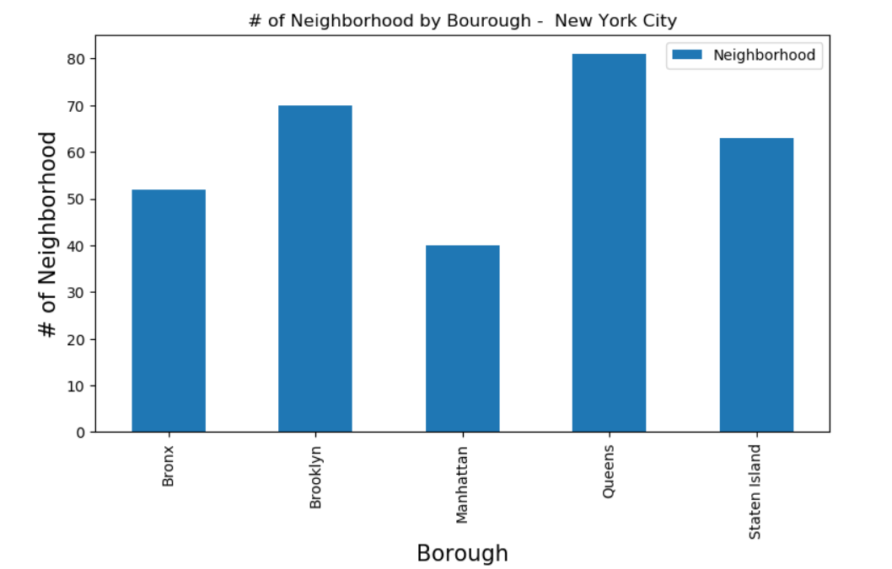
Neighborhoods by Borough
Queens has most number of neighborhood followed by Brooklyn

Slide 8
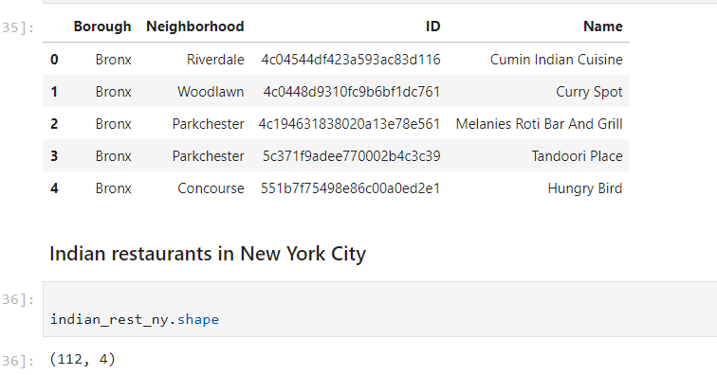
Indian Restaurants in New York
There are 112 Indian restaurants in New York City
( note : Data has been restricted due to limitations in API calls to FourSquare

Slide 9
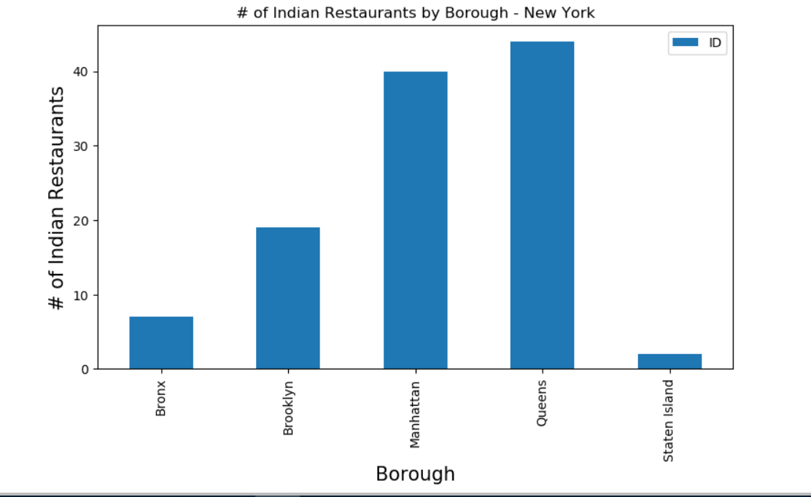
Indian Restaurants by Borough
Queens has the largest number of Indian restaurants followed by Manhattan

Slide 10
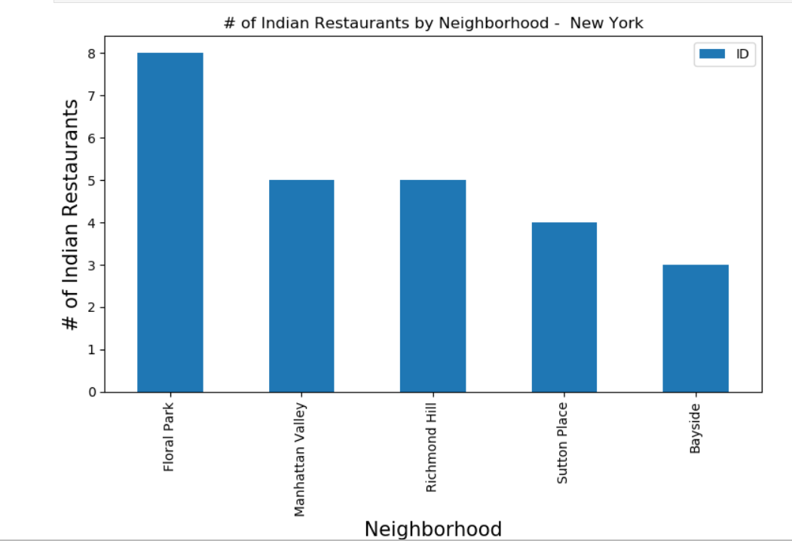
Indian Restaurants by Neighborhood
Floral Park neighborhood has the largest number of Indian restaurants

Slide 11
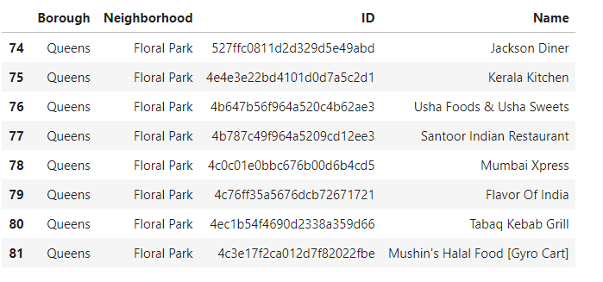
Floral Park restaurant details
Floral Park neighborhood has 8 Indian restaurants

Slide 12
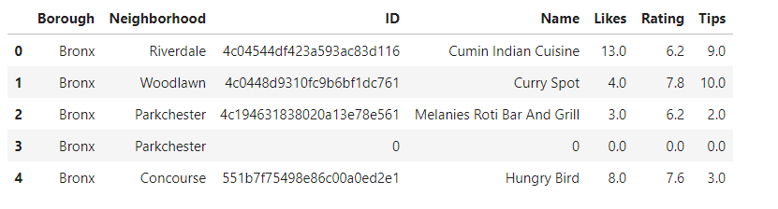
Restaurant details
Statistics of 50 restaurants with likes, ratings and tips

Slide 13
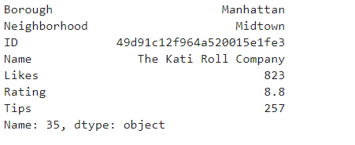
Most Liked Restaurant
Most liked restaurant is in borough Manhattan, neighborhood - Midtown

Slide 14
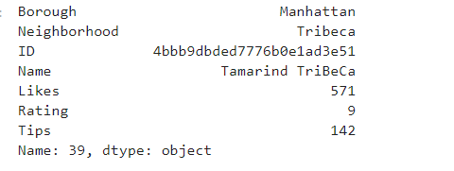
Most Rated Restaurant
Most liked restaurant is in borough Manhattan, neighborhood - Tribeca

Slide 15
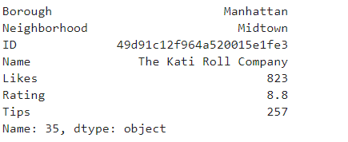
Most Tipped Restaurant
Most liked restaurant is in borough Manhattan, neighborhood - Midtown

Slide 16
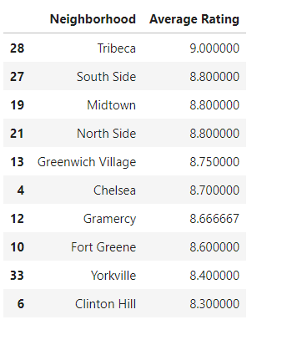
Top Average by Neighborhood
Most neighborhoods with top averages

Slide 17
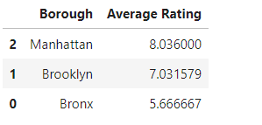
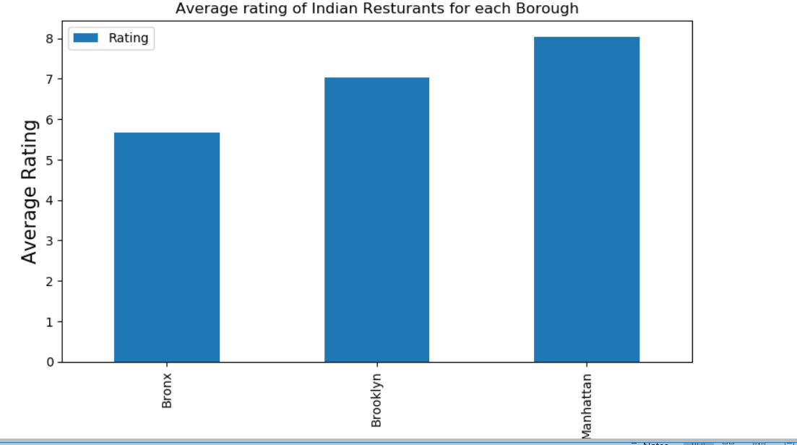
Top Average by Neighborhood/Borough
Manhattan look like a very popular place for Indian restaurants

Slide 18
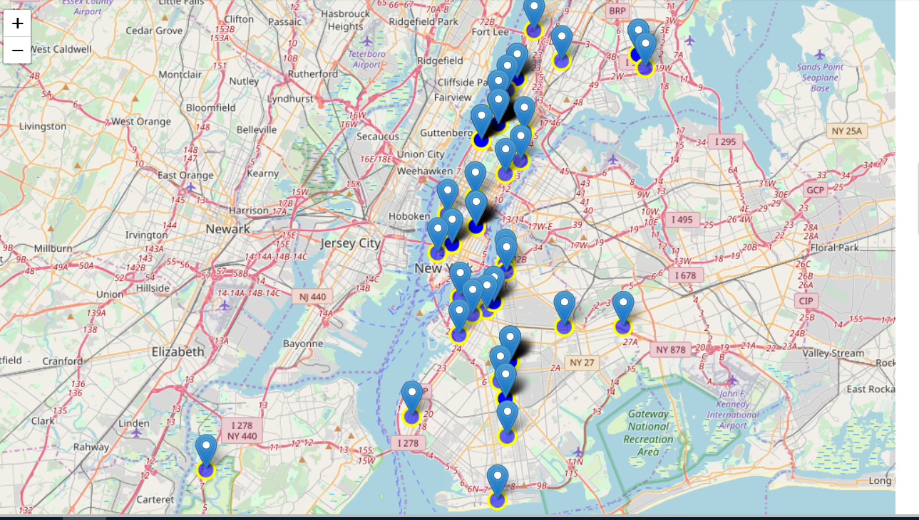

Slide 19
Observations
Most liked restaurant is also the most tipped one
Manhattan seems to be the best place for Indian restaurants
followed by Brooklyn
Queens has largest number of Indian restaurants followed by Brooklyn
and then Manhattan
Floral Park in Brooklyn has maximum Indian restaurants
Rating of restaurants is best in Manhattan followed by Brooklyn

Slide 20
Conclusions
Manhattan seems to be the best place for Indian restaurants
followed by Brooklyn
Though Queens has largest number of Indian restaurants ,
Indian restaurants are more liked and favored in Manhattan followed by
Brooklyn

Slide 21
Limitations
Analysis is based on limited data available from FourSquare.
Conclusion is based purely on ratings. likes and tips given in FourSquare

